Slide 1

20 December 2015

Slide 2


T-MOBILE: A TECHNOLOGY COMPANY

Slide 3
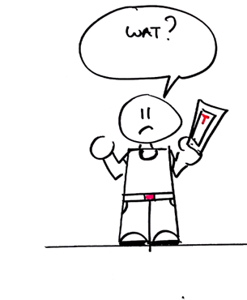

WORKING TOGETHER

Slide 4

WHY ARE WE DOING THIS

Slide 5

LIFE IS FOR SHARING

Slide 6









MEET OUR TEAM
Palupi Kusuma
Customer Intelligence Analyst @T-Mobile
Wouter van Diggelen
Front-End Developer
@T-Mobile
Armand Lacle
Front-End Developer
@T-Mobile
Ozhan Atar
Front-End Developer
@T-Mobile
Gordon Blom
Back-End Developer
@T-Mobile
Jasper Kamp
Front-End Developer
@T-Mobile
SPECIAL GUESTS:
Jihan Nizami
Web Developer
@eFocus
Terri Nova
Software Engineer
@CGI Netherlands

Slide 7

TOOLS & RESOURCES → HTTP://TMNL.NU/TECHIONISTA
Visual Studio Code:
https://code.visualstudio.com/Download
Chrome Browser: https://support.google.com/chrome/answer/95346?hl=en

Slide 8
AGENDA ON TODAY’S CODING CLASS
10:00 – 10:10 Introduction
10:10 – 12:30 HTML & CSS
Theory and live coding example
12:30 – 13:15 Lunch
13:15 – 17:00 Hands-on session: Build your own webpage
17:00 – 17:20 Show off session
17:20 – 18:30 Closing and Happy hour

Slide 9
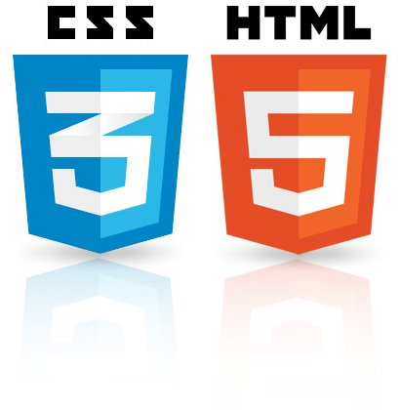
GET STARTED WITH HTML & CSS
Browser (client) vs. server
HTML
Introduction
Syntax
Structure
HTML elements and attributes
Styling
CSS
Introduction
Syntax
Class vs. ID
Elements
Positioning

Slide 10
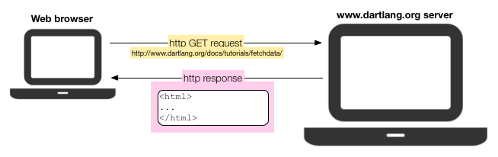

HOW WEB BROWSER (CLIENT) COMMUNICATES WITH SERVER

Slide 11
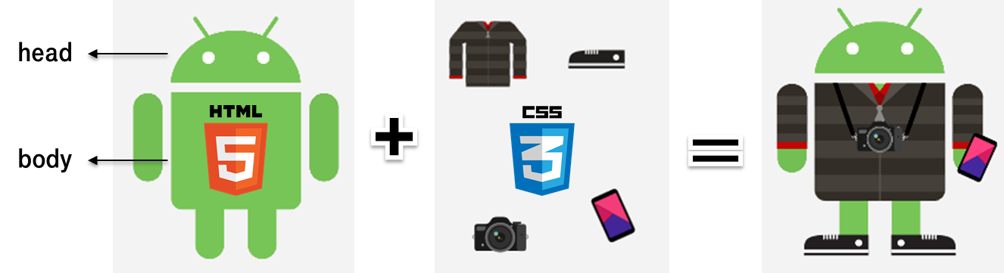
HTML & CSS ARE BFF FOR LIFE

Slide 12

WHAT IS HTML?
HTML stands for Hyper Text Markup Language
Introduced in the 1990’s
Browser reads HTML files and renders it into web pages
Clearly visible with.html extension
HTML documents are described by HTML tags and attributes

Slide 13
HTML SYNTAX
HTML documents are described by HTML tags
Each HTML tag describes different document content
tips: write in consistent manner in e.g., lower case
Tags come in pairs: an opening tag and a closing tag.
<p> …...content……</p>
HTML element with attributes
<p id=“text”> …...content……</p>
Opening tags
Closing tags
attribute
value
Closing tags
Opening tags

Slide 14
HTML STRUCTURE
<!DOCTYPE html>
<html>
<head>
<meta name="keywords" content="HTML, CSS, Techionista">
<meta name="description" content=“A simple web page">
<title>My first web page at Techionista Coding Class </title>
</head>
<body>
Hello world!
</body>
</html>
1
5
3
6
2
4
Notes:
DOCTYPE
Always put <!DOCTYPE html> on the first line.
This tells the browser what language it's reading (in this case, HTML).
HEAD
The head contains information about your HTML file, like its title. The title is what we see in the browser's title bar or page tab.
Meta information
Link to css
Link to script
BODY
The body is where you put your content, such as text, images, and links. The content in the body is what will be visible on the actual page.

Slide 15
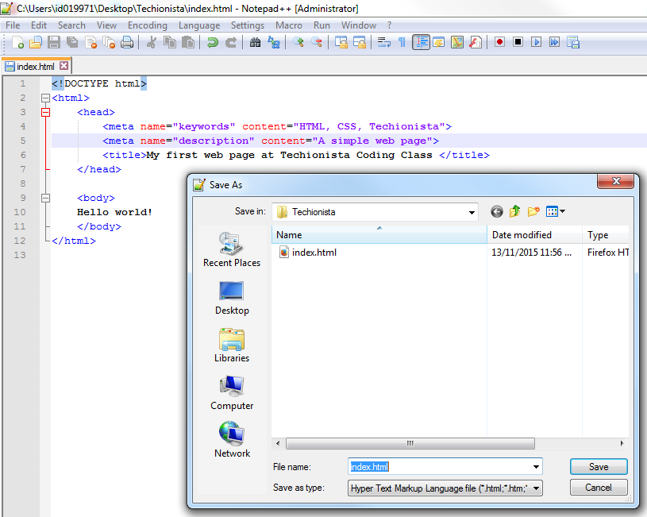
WE HAVE OUR FIRST WEBPAGE, YES! SAVE IT AS INDEX.HTML

Slide 16

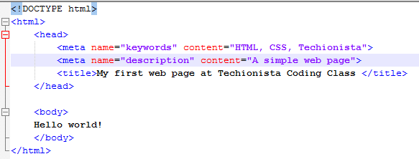
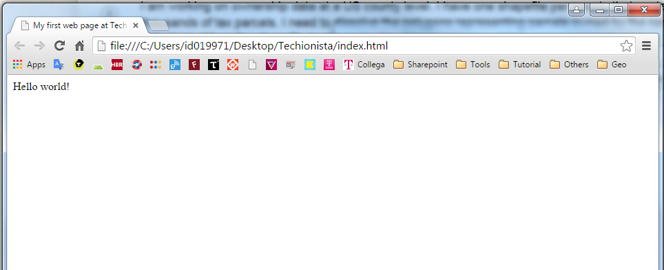
VIEW IT ON YOUR (FAVORITE) BROWSER
FROM THIS
TO THIS

Slide 17
HTML ELEMENTS AND ATTRIBUTES
Paragraph <p id=“text”> …...content……</p>
Headings <h1> this is my heading 1 </h1>
<h2> this is my heading 2 </h2>
<h3> this is my heading 3 </h3>
……
<h6> this is my heading 3 </h6>
attribute
value
Closing tags
Opening tags

Slide 18
HTML ELEMENTS AND ATTRIBUTES
Hyperlinks <a href=“http://koko.org”>kitten </a>
Image <img src=“cat.png” />
Nested HTML Elements
Image + link
<a href=“http://koko.org”>
<img src=“kitten.png” />
</a>
Multimedia
Youtube <iframe width="420" height="315" src="http://www.youtube.com/embed/XGSy3_Czz8k?autoplay=1" />

Slide 19
HTML ELEMENTS AND ATTRIBUTES
Division = block element
<div>div is really a versatile container
<div>… you can put HTML elements inside div… </div>
</div>
Span = inline element
<span>Similar to div, but for wrapping smaller piece </span>

Slide 20
HTML ELEMENTS AND ATTRIBUTES
List <ul>
<li>apple </li>
<li>orange </li>
</ul>
Table <table>
<tr>
<td>first column </td>
<td>second column </td>
</tr>
</table>

Slide 21
HTML STYLING IN 3 WAYS
<html>
<head>
<!– external CSS -->
<link type="text/css" rel="stylesheet" href="styles.css“ />
<style>
/* Internal CSS */
h2 { color : green; text-align : center;}
</style>
</head>
<body>
<!– inline CSS -->
<h1 style="color:blue; text-align:center"> first heading </h1>
</body>
</html>

Slide 22

WHAT IS CSS?
CSS stands for Cascading Style Sheets
CSS is a language to control appearance and formatting of HTML
It can control the layout of multiple Web pages all at once
Clearly visible with.css extension
Link it within the <head> section in HTML
<link type="text/css" rel="stylesheet" href="styles.css“ />

Slide 23
CSS SYNTAX
Anatomy of CSS is slightly different than HTML syntax
h1
{
color : blue;
text-align : center;
}
Property
Value
Selector
Opening
& Closing
Brackets
Declaration = Property + Value

Slide 24
CSS ELEMENTS & ATTRIBUTES
Default font
h1
{
font-family : "Times New Roman", Times, serif;
}
Using external font (e.g., https://www.google.com/fonts)
<link href='https://fonts.googleapis.com/css?family=Caveat' rel='stylesheet' type=‘text/css’ >

Slide 25
CONNECT HTML ELEMENT WITH CSS via CLASS & ID
<p class=“ColorRed”> …...content……</p>
Classes are useful when you have a bunch of elements that should all receive the same styling
.ColorRed { text-align: center; color: red; }
<p id=“ColorBlue”>…...content……</p>
IDs, on the other hand, are great for when you have exactly one element that should receive a certain kind of styling.
#ColorBlue { text-align: center; color: blue; }

Slide 26
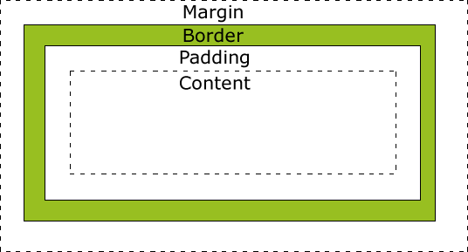
CSS POSITIONING
Margin, border, padding properties define the space around elements.
p { margin-top: 100px;
margin-bottom: 100px;
}

Slide 27
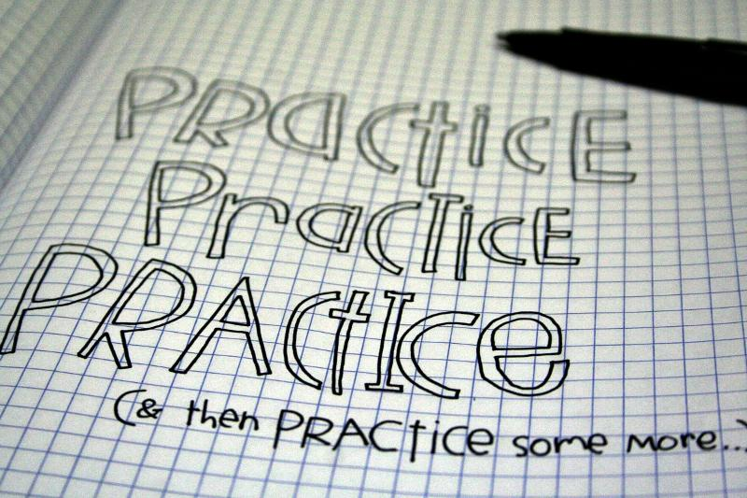

TIPS & TRICKS
Chrome Dev Tool to inspect element (F12)
Right click on the webpage and “View Page Source”
Google is your best friend
Keyword tips: “html [element you want]”

Slide 28


Slide 29
AGENDA ON TODAY’S CODING CLASS
10:00 – 10:10 Introduction
10:10 – 12:30 HTML & CSS
Theory and live coding example
12:30 – 13:15 Lunch
13:15 – 17:00 Hands-on session: Build your own webpage
17:00 – 17:20 Show off session
17:20 – 18:30 Closing and Happy hour

Slide 30

HANDS-ON SESSION: BUILD YOUR OWN WEBPAGE

Slide 31
HANDS-ON SESSION: BUILD YOUR OWN WEBPAGE
header
menu1 – menu2 – menu3
add some content
footer
1
2
3
4

Slide 32

HUNGRY FOR MORE? CHECK THESE OUT!
Learn how to create websites with HTML and CSS
https://www.codecademy.com/learn/web
E-book HTML & CSS Design and Build Websites By Jon Duckett
http://wtf.tw/ref/duckett.pdf
A course on HTML, CSS and JavaScript (HTML & CSS section is free)
https://www.coursera.org/learn/html-css-javascript/home/week/1
Tutorial source for HTML, CSS and more
http://www.w3schools.com/html/default.asp

Slide 33


